Slide 1
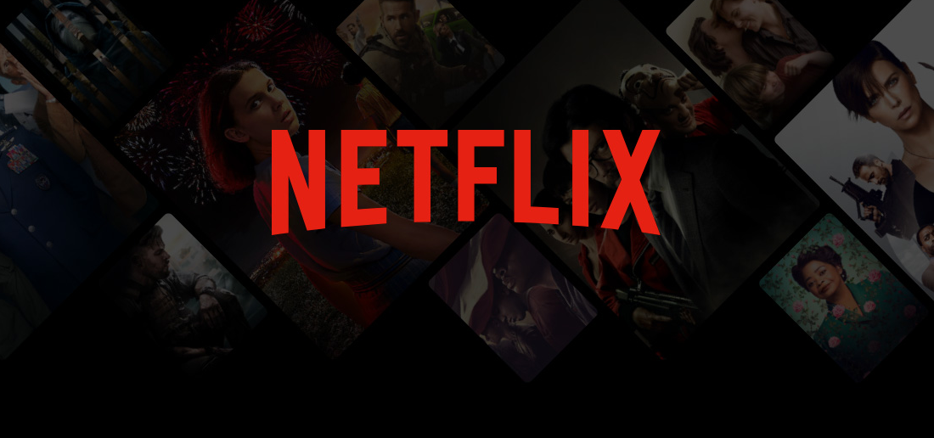
Business Analytics
SWOT ANALYSIS & GROWTH SHARE MATRIX FOR NETFLIX

Slide 2
Introduction
Netflix is a global leader in the streaming industry, offering a vast library of movies, TV shows, and original content to subscribers in over 190 countries.
Founded in 1997 as a DVD rental service, the company transitioned to streaming in 2007 and has since revolutionized the entertainment landscape.
Through its focus on technology, personalization, and original programming, Netflix has built a strong brand presence and a loyal subscriber base.
With a subscription-based model, strategic partnerships, and continuous innovation, Netflix remains a dominant player in the competitive streaming market.

Slide 3
Swot [Strengths]
Strong Brand Recognition: A leading global streaming platform with a well-established brand.
Extensive Content Library: Offers a vast catalog of movies, TV shows, and original productions.
Global Reach: Available in over 190 countries with localized content.
Technology & Personalization: Advanced algorithms for content recommendations.
Original Content Production: Successful original programming (e.g. ‘Stranger Things’, ‘Squid Game’)
Subscription-Based Model: Reliable and predictable revenue streams.

Slide 4
Swot [WEAKNESSES]
High Content Costs: Significant spending on content production and licensing.
Subscriber Churn: Users may cancel subscriptions due to rising costs or competition.
Dependency on Licensing Agreements: Relies on third-party content that can be removed.
Price Sensitivity: Price increases may drive customers to competitors.
Limited Revenue Streams: Mostly reliant on subscription fees, unlike competitors with ad-supported models.

Slide 5
Swot [Opportunities]
Ad-Supported Subscription Tiers: Potential for new revenue from ads.
Expansion into Gaming: Opportunity to diversify entertainment offerings.
Localization & Regional Content: Investing in non-English productions to capture diverse markets.
Technological Innovations: AI-driven content recommendations and interactive storytelling.
Strategic Partnerships: Collaborations with telecom providers, device manufacturers, and production studios.

Slide 6
Swot [Threats]
Intense Competition: Rivals like Disney+, HBO Max, Amazon Prime Video and Hulu.
Market Saturation: Slowing subscriber growth in key markets.
Regulatory Challenges: Compliance with international media and content regulations.
Piracy & Content Sharing: Unauthorized access and password sharing reduce potential revenue.
Economic Downturns: Budget-conscious consumers may cut streaming subscriptions.

Slide 7

GROWTH SHARE MATRIX
Stars (High Growth, High Market Share)
Original Content (Netflix Originals): Popular shows and movies like ‘Stranger Things’, ‘The Witcher’, and ‘Squid Game’ drive engagement and attract new subscribers.
International Markets (Localization & Regional Content): Expanding in Asia, Latin America, and Europe with localized productions like ‘Money Heist’ and ‘Lupin’.
Cash Cows (Low Growth, High Market Share)
Subscription Model: The core business generating consistent revenue, especially in mature markets like North America and Europe.
Established Licensed Content: Shows and movies with strong fan bases that keep existing subscribers engaged (e.g., ‘Friends’, ‘Breaking Bad’ when available).

Slide 8
GROWTH SHARE MATRIX
Question Marks (High Growth, Low Market Share)
Ad-Supported Subscription Tier: A newer venture with potential to attract budget-conscious viewers and diversify revenue streams.
Gaming Expansion: Netflix is investing in mobile and cloud gaming, but it remains uncertain if this will become a strong revenue driver.
Dogs (Low Growth, Low Market Share)
Niche Genres with Limited Audience: Some experimental content that doesn't gain significant traction, leading to cancellations.

